Slide 1
Chapter 2 Architectural Details and Assembly Language Programming of 8085 MPU
Credit: 10 hrs

Slide 2
Overview:
Internal architecture and description
Instruction classification
Addressing modes
Instruction Cycle, Machine cycle, t-state, Timing diagram, RTL
Basic Assembly language programs of 8085

Slide 3
1. Internal architecture and description

Slide 4
8085 Microprocessor: Introduction
8085 is pronounced as "eighty-eighty-five" microprocessor. It is an 8-bit microprocessor designed by Intel in 1977 using NMOS technology.
It has the following configuration −
8-bit data bus
16-bit address bus, which can address upto 64KB
A 16-bit program counter
A 16-bit stack pointer
Six 8-bit registers arranged in pairs: BC, DE, HL
Requires +5V supply to operate at 3.2 MHZ single phase clock
It is used in washing machines, microwave ovens, mobile phones, etc
Notes:
N-channel Metal Oxide Semiconductor: is a microelectronic circuits used for logic and memory.

Slide 5
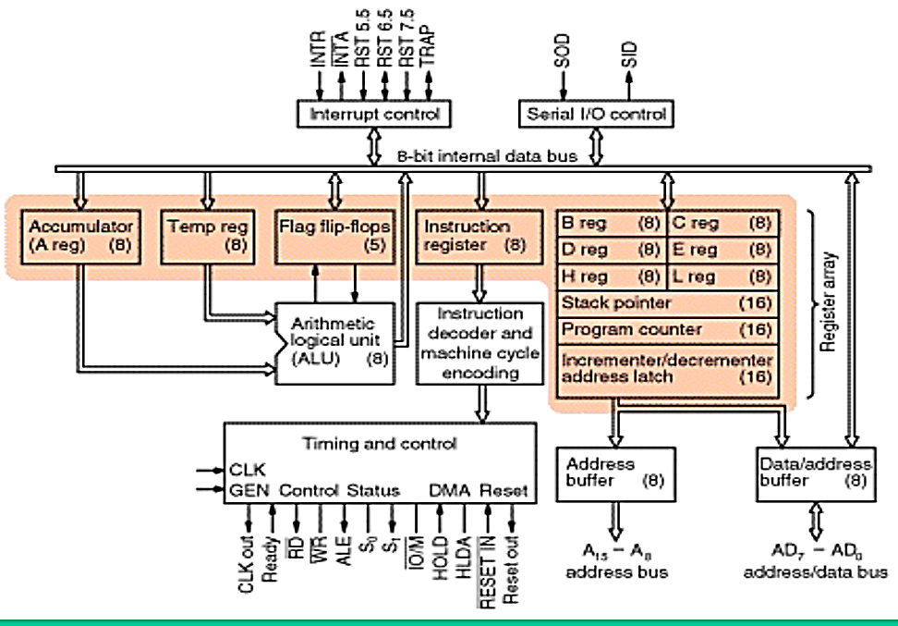
8085 MP- Block Diagram

Slide 6
8085 MP- functional Units
Accumulator
Arithmetic and logic unit
General purpose register
Program counter
Stack pointer
Flag register
Instruction register and decoder
Timing and control unit
Interrupt control
Serial Input/output control
Address buffer and address-data buffer
Address bus and data bus

Slide 7
8085 MP- functional Units
Accumulator
It is an 8-bit register used to store arithmetic, logical, I/O & LOAD/STORE operation results.
It is connected to internal data bus & ALU.
Arithmetic and logic unit
It performs arithmetic and logical operations like Addition, Subtraction, AND, OR, etc. on 8-bit data.
General purpose register
There are 6 general purpose registers in 8085 processor, i.e. B, C, D, E, H & L.
Each register can hold 8-bit data.
These registers can work in pair to hold 16-bit data and their pairing combination is like B-C, D-E & H-L.

Slide 8
8085 MP- functional Units
Program counter (PC)
It is a 16-bit register used to store the memory address location of the next instruction to be executed.
The PC is incremented after each instruction is executed.
Then, the PC points to the memory address of the next instruction that is going to be executed.
Stack pointer
It is also a 16-bit register works like stack.
It keeps track of the TOS (top of stack).
It is always incremented/decremented by 2 during push & pop operations.
Temporary register
It is an 8-bit register, which holds the temporary data of arithmetic and logical operations.

Slide 9

8085 MP- functional Units
Flag register
It is an 8-bit register having five 1-bit flip-flops, which holds either 0 or 1 depending upon the result stored in the accumulator.
These are the set of 5 flip-flops −
Sign (S)
Zero (Z)
Auxiliary Carry (AC)
Parity (P)
Carry
Its bit position is shown in the following table :
Instruction Register and Decoder
It stores the instruction fetched from the memory.
Instruction decoder decodes the information present in the IR.

Slide 10
8085 MP- functional Units
Timing and control unit
It provides timing and control signal to the microprocessor to perform operations.
Following are the timing and control signals, which control external and internal circuits −
Control Signals: READY, RD’, WR’, ALE
Status Signals: S0, S1, IO/M’
DMA Signals: HOLD, HLDA
RESET Signals: RESET IN, RESET OUT
Interrupt control
It controls the interrupts during a process.
When a microprocessor is executing a main program and whenever an interrupt occurs, the microprocessor shifts the control from the main program to process the incoming request.
After the request is completed, the control goes back to the main program.
There are 5 interrupt signals in 8085 microprocessor: INTR, RST 7.5, RST 6.5, RST 5.5, TRAP.
ALE: Address Latch Enable

Slide 11
8085 MP- functional Units
Serial Input/output control
It controls the serial data communication by using these two instructions: SID (Serial input data) and SOD (Serial output data).
Address buffer and address-data buffer
The content stored in the stack pointer and PC is loaded into the address buffer and address-data buffer to communicate with the CPU.
The memory and I/O chips are connected to these buses; the CPU can exchange the desired data with the memory and I/O chips.
Address bus and data bus
Data bus carries the data to be stored. It is bidirectional.
Address bus carries the location (address) to where it should be stored and it is unidirectional.

Slide 12
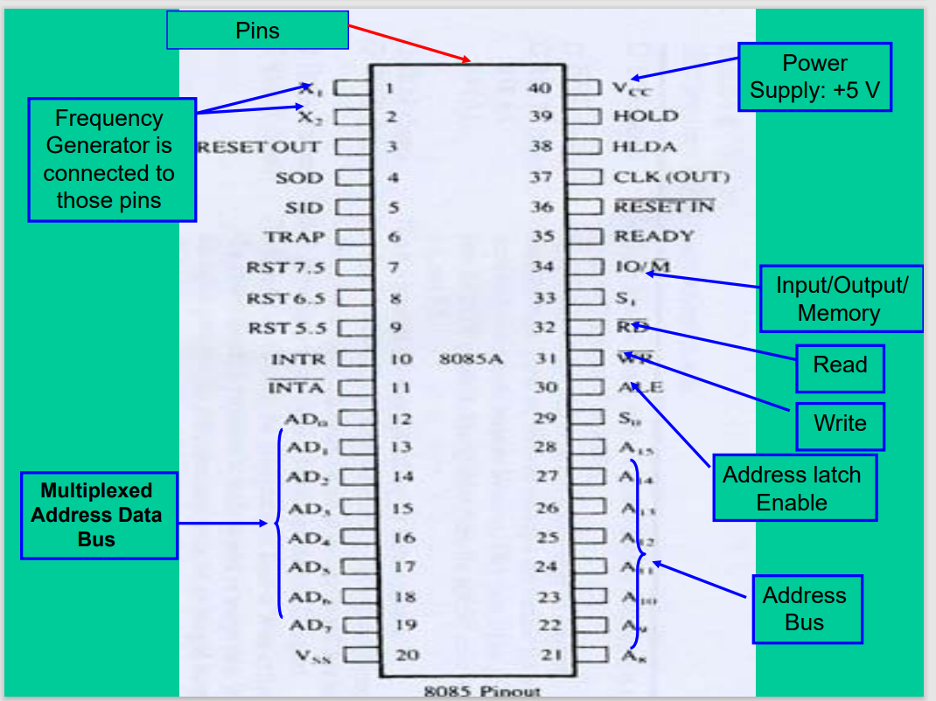
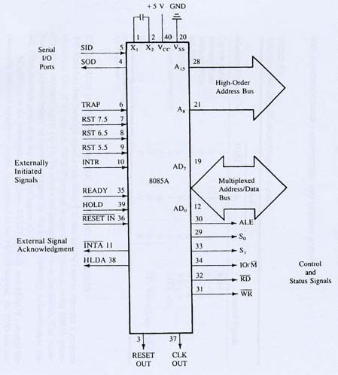
8085 Pin Configuration
The pins of a 8085 microprocessor can be classified into seven groups −
Address Bus
Data Bus
Control and Status Signals
Power Supply
Clock Signals
Interrupts & Externally initiated signals
Serial I/O signals

Slide 13
8085 Pin Configuration
Address bus
A15-A8, it carries the most significant 8-bits of memory/IO address.
Data bus
AD7-AD0, it carries the least significant 8-bit address and data bus.
Power supply
There are 2 power supply signals − VCC & VSS.
VCC indicates +5v power supply and
VSS indicates ground signal.
Clock signals
There are 3 clock signals, i.e. X1, X2, CLK OUT.
X1, X2 − A crystal (RC, LC N/W) is connected at these two pins and is used to set frequency of the internal clock generator. This frequency is internally divided by 2.
CLK OUT − This signal is used as the system clock for devices connected with the microprocessor

Slide 14
8085 Pin Configuration
5. Control and status signals
These signals are used to identify the nature of operation.
There are 3 control signal and 3 status signals.
Three control signals are RD’, WR & ALE.
RD’ − This signal indicates that the selected IO or memory device is to be read and is ready for accepting data available on the data bus.
WR’ − This signal indicates that the data on the data bus is to be written into a selected memory or IO location.
ALE − It is a positive going pulse generated when a new operation is started by the microprocessor. When the pulse goes high, it indicates address. When the pulse goes, down it indicates data.
Three status signals are IO/M’, S0 & S1.
IO/M’: This signal is used to differentiate between IO and Memory operations, i.e.
when it is high indicates IO operation and
when it is low then it indicates memory operation.
S1 & S0: These signals are used to identify the type of current operation.

Slide 15
8085 Pin Configuration
Interrupts & externally initiated signals
Interrupts are the signals generated by external devices to request the microprocessor to perform a task.
There are 5 interrupt signals, i.e. TRAP, RST 7.5, RST 6.5, RST 5.5, and INTR.
INTA − It is an interrupt acknowledgment signal.
RESET IN − This signal is used to reset the microprocessor by setting the PC to zero.
RESET OUT − This signal is used to reset all the connected devices when the microprocessor is reset.
READY − This signal indicates that the device is ready to send or receive data. If READY is low, then the CPU has to wait for READY to go high.
HOLD − This signal indicates that another master is requesting the use of the address and data buses.
HLDA (HOLD Acknowledge) − It indicates that the CPU has received the HOLD request and it will relinquish the bus in the next clock cycle. HLDA is set to low after the HOLD signal is removed.

Slide 16
8085 Pin Configuration
Serial I/O signals
There are 2 serial signals, i.e. SID and SOD and these signals are used for serial communication.
SOD (Serial output data line) − The output SOD is set/reset as specified by the SIM instruction.
SID (Serial input data line) − The data on this line is loaded into accumulator whenever a RIM instruction is executed.

Slide 17
2. Instruction classification

Slide 18
Instruction classification
An instruction is a binary pattern designed inside a microprocessor to perform a specific function.
The entire group of instructions is called instruction set.
Instruction set determines what functions the microprocessor can perform.
Since the 8085 is an 8-bit device it can have up to 2⁸ (256) instructions.
However, the 8085 only uses 246 combinations that represent a total of 74 instructions.
Most of the instructions have more than one format.
Each instruction has two parts.
The first part is the task or operation to be performed.
This part is called the “opcode” (operation code).
The second part is the data to be operated on
Called the “operand”.

Slide 19
Instruction classification
These instructions can be grouped into five different groups:
Data Transfer Instructions
Arithmetic Instructions
Logic Instructions
Branching Instructions
Machine Control Instructions

Slide 20
1. Data Transfer Operations
Data transfer instructions are the instructions that transfer data in the microprocessor.
They are also called copy instructions.
The data in the source is not changed.
They transfer:
Data between registers.
Data Byte to a register or memory location.
Data between a memory location and a register.
Data between an I\O Device and the accumulator.
Some of the Data transfer instruction are: MVI, LDA, STA,XCH, PUSH, POP,….

Slide 21
Opcode | Operand | Explanation of Instruction | Example
MOV | Rd, Rs M, Rs Rd, M | Copy from source(Rs) to destination(Rd) | MOV B, C or MOV B, M
MVI | Rd, data M, data | Move immediate 8-bit | MVI B, 57H or MVI M, 57H
LDA | 16-bit address | Load accumulator | LDA 2034H
LDAX | B/D Reg. pair | Load accumulator indirect | LDAX B
LXI | Reg. pair, 16-bit data | Load register pair immediate | LXI H, 2034H
LHLD | 16-bit address | Load H and L registers direct | LHLD 2040H
STA | 16-bit address | 16-bit address | STA 4350H
STAX | Reg. pair | Store accumulator indirect | STAX B
SHLD | 16-bit address | Store H and L registers direct | SHLD 2470H
XCHG | none | Exchange H and L with D and E | XCHG
SPHL | none | Copy H and L registers to the stack pointer | SPHL
XTHL | none | Exchange H and L with top of stack | XTHL
PUSH | Reg. pair | Push register pair onto stack | PUSH B or PUSH A
POP | Reg. pair | Pop off stack to register pair | POP H or POP A
OUT | 8-bit port address | Output data from accumulator to a port with 8-bit address | OUT F8H
IN | 8-bit port address | Input data to accumulator from a port with 8-bit address | IN 8CH

Slide 22
2. Arithmetic Operations
Data transfer instructions are the instructions that perform arithmetic operations such as addition, subtraction, increment and decrement.
Addition: Any 8-bit number or contents of a register or contents of a memory location can be added to the contents of the accumulator and the result is stored in the accumulator.
Subtraction: Any 8-bit number or contents of a register or contents of a memory location can be subtracted from the contents of the accumulator and the result is stored in the accumulator.
Increment/decrement: The 8-bit contents of any memory location or any register can be directly incremented or decremented by 1. No need to disturb the contents of the accumulator.

Slide 23
Opcode | Operand | Meaning | Example
ADD | R M | Add register or memory, to the accumulator | ADD K
ADC | R M | Add register to the accumulator with carry | ADC K
ADI | 8-bit data | Add the immediate to the accumulator | ADI 55K
ACI | 8-bit data | Add the immediate to the accumulator with carry | ACI 55K
LXI | Reg. pair, 16bit data | Load the register pair immediate | LXI K, 3025M
DAD | Reg. pair | Add the register pair to H and L registers | DAD K
SUB | R M | Subtract the register or the memory from the accumulator | SUB K
SBB | R M | Subtract the source and borrow from the accumulator | SBB K
SUI | 8-bit data | Subtract the immediate from the accumulator | SUI 55K
XCHG | None | Exchange H and L with D and E | XCHG
INR | R M | Increment the register or the memory by 1 | INR K
INX | R | Increment register pair by 1 | INX K
DCR | R M | Decrement the register or the memory by 1 | DCR K
DCX | R | Decrement the register pair by 1 | DCX K
DAA | None | Decimal adjust accumulator | DAA

Slide 24
3. Logical Operations
These instructions perform logic operations on the contents of the accumulator.
ANA, ANI, ORA, ORI, XRA and XRI
Source: Accumulator and
An 8-bit number
The contents of a register
The contents of a memory location
Destination: Accumulator
ANA | R/M | AND Accumulator With Reg/Mem
ANI | # | AND Accumulator With an 8-bit number
ORA | R/M | OR Accumulator With Reg/Mem
ORI | # | OR Accumulator With an 8-bit number
XRA | R/M | XOR Accumulator With Reg/Mem
XRI | # | XOR Accumulator With an 8-bit number

Slide 25
4. Branching Operations
This group of instructions alters the sequence of program execution either conditionally or unconditionally.
The addresses supplied to all branch operations must be 16-bits.
Unconditional branch.
Go to a new location no matter what.
Conditional branch.
Go to a new location if the condition is true

Slide 26
Unconditional Branch
Conditional Branch
JMP Address
Jump to the address specified (Go to).
CALL Address
Jump to the address specified but treat it as a subroutine.
RET
Return from a subroutine.
The addresses supplied to all branch operations must be 16-bits.
Go to new location if a specified condition is met.
JZ Address (Jump on Zero)
Go to address specified if the Zero flag is set.
JNZ Address (Jump on NOT Zero)
Go to address specified if the Zero flag is not set.
JC Address (Jump on Carry)
Go to the address specified if the Carry flag is set.
JNC Address (Jump on No Carry)
Go to the address specified if the Carry flag is not set.
JP Address (Jump on Plus)
Go to the address specified if the Sign flag is not set
JM Address (Jump on Minus)
Go to the address specified if the Sign flag is set.

Slide 27
5. Machine control Operations
These instructions control machine functions such as Halt, Interrupt or Do-nothing
HLT
Stop executing the program.
NOP
No operation
Exactly as it says, do nothing.
Usually used for delay or to replace instructions during debugging.
EI : Enable Interrupts
DI : Disable Interrupts
NOP : No operation
HLT : Halt the processor
SIM : Set Interrupt Mask
RID : Read Interrupt Mask

Slide 28
3. Addressing modes

Slide 29
Addressing modes in 8085
The microprocessor has different ways of specifying the data for the instruction. These are called “addressing modes”.
The 8085 has five addressing modes:
Immediate Addressing mode
Register Addressing mode
Direct Addressing mode
Indirect Addressing mode
Implied Addressing mode

Slide 30
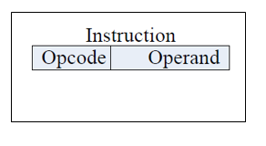
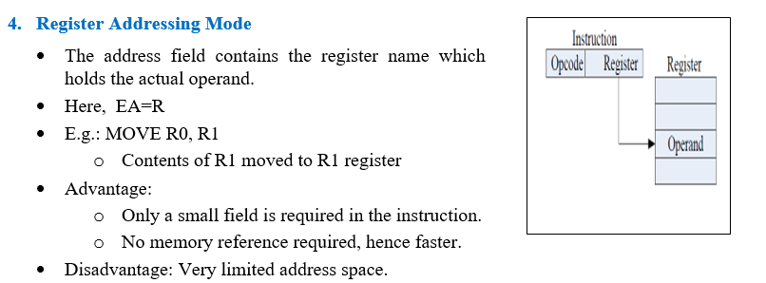
Immediate addressing mode
In this mode, the 8/16-bit data is specified in the instruction itself as one of its operand.
For example: MVI K, 20H
means 20H is copied into register K.
Register addressing mode
In this mode, the data is copied from one register to another.
For example: MOV K, B
means data in register B is copied to register K.

Slide 31
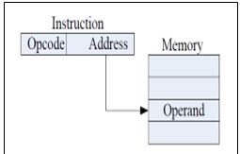
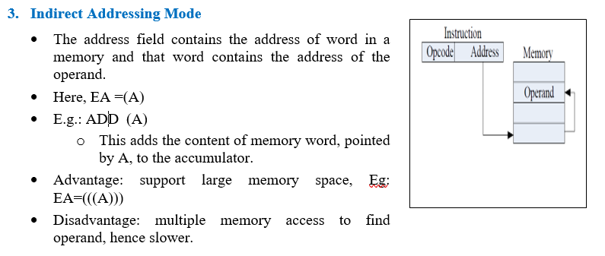
Direct addressing mode
In this mode, the data is directly copied from the given address to the register.
When instruction explicitly states the location of an operand or a destination(either in memory or in a processor register), the addressing mode is known as direct addressing.
For example: LDB 5000K
means the data at address 5000K is copied to register B.
Indirect addressing mode
In this mode, the data is transferred from one register to another by using the address pointed by the register.
For example: MOV K, B
means data is transferred from the memory address pointed by the register to the register K.
Implied addressing mode
This mode doesn’t require any operand; the data is specified by the opcode itself.
For example: CMP

Slide 32
4. Instruction Cycle, Machine cycle, t-state, Timing diagram, RTL

Slide 33
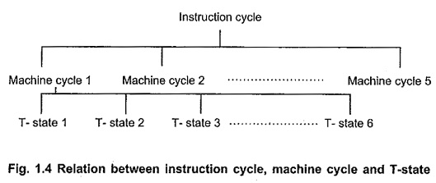
Instruction Cycle, Machine Cycle and T-state

Slide 34
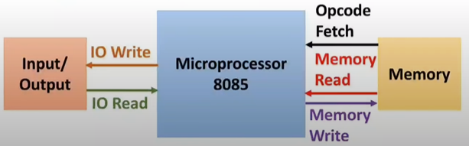
Instruction Cycle, Machine Cycle and T-state
During normal operation, the microprocessor sequentially fetches, decodes and executes one instruction after another until a halt instruction (HLT) is executed.
The fetching, decoding and execution of a single instruction constitutes an instruction cycle, which consists of one to six read or write operations between processor and memory or input/output devices.

Slide 35
Instruction Cycle, Machine Cycle and T-state
Each memory or I/O operation requires a particular time period, called machine cycle.
The time needed for completing one operation of accessing memory, I/O or acknowledging an external request is termed as Machine cycle.
In other words, to move a byte of data in or out of the microprocessor, a machine cycle is required.
To move 1 byte of data, 1 machine cycle is required. To move 2 byte of data, machine cycles are required.

Slide 36
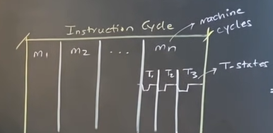
Instruction Cycle, Machine Cycle and T-state
Machine cycle is comprised of T-states.
One subdivision of the operation completed in one clock period is termed as T-state.
Each machine cycle consists of 3 to 6 clock periods/cycles, referred to as T-states.
T-stare = 1/3 MHz = 0.333 micro sec.
Reference: https://www.youtube.com/watch?v=GoPh2PS25AU

Slide 37
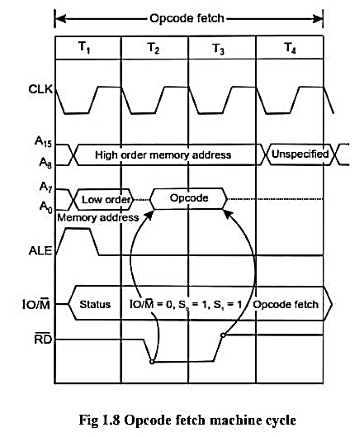
Timing Diagram
Timing Diagram is a graphical representation of execution time taken by each instruction in a graphical format.
The execution time is represented in T-states.

Slide 38
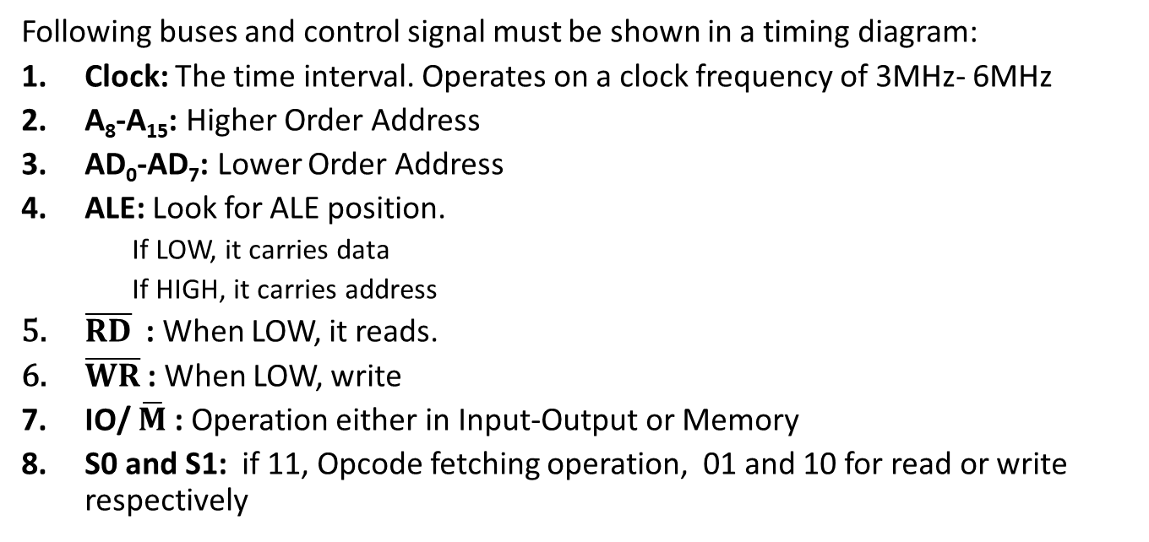
Some Basics for Timing Diagram
Following buses and control signal must be shown in a timing diagram:
Clock: The time interval. Operates on a clock frequency of 3MHz- 6MHz
A₈-A₁₅: Higher Order Address
AD₀-AD₇: Lower Order Address
ALE: Look for ALE position.
If LOW, it carries data
If HIGH, it carries address
$\overline{RD}$: When LOW, it reads.
$\overline{WR}$: When LOW, write
IO/ $\overline{M}$ : Operation either in Input-Output or Memory
S0 and S1: if 11, Opcode fetching operation, 01 and 10 for read or write respectively

Slide 39
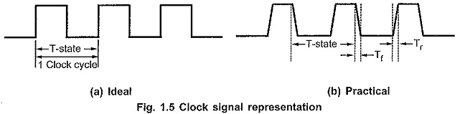
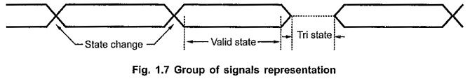
Representation of 8085 signals
Clock Signal
Group of signals

Slide 40
Summary:
Instruction Cycle:
The time required to execute an instruction is called instruction cycle.
Machine Cycle:
The time required to access the memory or input/output devices is called machine cycle.
T-State:
The machine cycle and instruction cycle takes multiple clock periods.
A portion of an operation carried out in one system clock period is called as T-state.
Timing diagram:
Timing Diagram is a graphical representation of execution time taken by each instruction in a graphical format.

Slide 41
Instruction Cycle
The execution of each instruction involves a series of steps known as the instruction cycle.
The instruction cycle of the 8085 microprocessor consists of four basic steps, which are:
Fetch: In this step, the microprocessor fetches the instruction from the memory location pointed to by the program counter (PC). The PC is incremented by one after the fetch operation.
Decode: Once the instruction is fetched, the microprocessor decodes it to determine the operation to be performed and the operands involved.
Execute: In this step, the microprocessor performs the operation specified by the instruction on the operands.
Store: Finally, the result of the execution is stored in the appropriate memory location or register.
Once the execution of an instruction is complete, the microprocessor returns to the fetch step to fetch the next instruction to be executed. This cycle repeats until the program is complete or interrupted

Slide 42
Why need the Instruction cycle in 8085 microprocessor ?
The instruction cycle is a fundamental concept in the operation of the 8085 microprocessor because it is the process by which the microprocessor fetches, decodes, and executes instructions.
The execution of a program in a microprocessor involves a sequence of instructions, and each instruction is executed using the instruction cycle.
The instruction cycle is necessary in the 8085 microprocessor because it ensures that the instructions are executed in the correct sequence and that the correct operation is performed on the correct data.
The fetch step ensures that the correct instruction is obtained from memory, the decode step ensures that the correct operation is determined, and the execute step ensures that the correct operation is performed on the correct data.
Furthermore, the instruction cycle allows the microprocessor to execute instructions at a very high speed, which is critical in applications where real-time performance is required.
By efficiently executing instructions using the instruction cycle, the microprocessor can perform complex tasks and computations quickly and accurately.

Slide 43
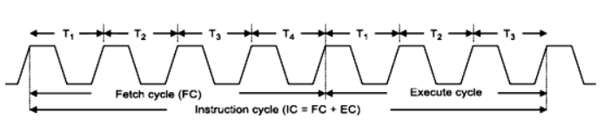
Instruction Cycle
An instruction is a command given to the microprocessor to perform a specific operation on the given data.
Sequence of instructions written for a processor to perform a particular task is called a program.
Program & data are stored in the memory.
The microprocessor fetches one instruction from the memory at a time & executes it. It executes all the instructions of the program one by one to produce the final result.
The necessary steps that a microprocessor carries out to fetch an instruction & necessary data from the memory & to execute it constitute an instruction cycle.
In other words, an instruction cycle is defined as the time required for completing the execution of an instruction.
An instruction cycle consists of a fetch cycle and an execute cycle.
The time required to fetch an opcode (fetch cycle) is a fixed slot of time while the time required to execute an instruction (execute cycle) is variable which depends on the type of instruction to be executed.
Instruction cycle(IC) = Fetch cycle(FC)+ Execute cycle(EC)

Slide 44
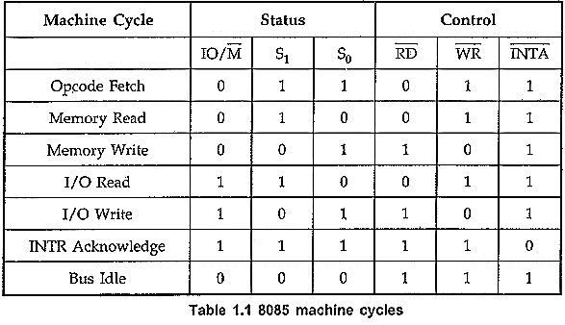
Machine Cycle
The seven Machine Cycle in 8085 Microprocessor are :
Opcode Fetch Cycle
Memory Read
Memory Write
I/O Read
I/O Write
Interrupt Acknowledge
Bus Idle
Three status signals IO/M, S₁ and S₀ identify each type as shown in Table 1.1.
These signals are generated at the beginning of each machine cycle and remained valid for the duration, of the cycle.
Reference : https://www.eeeguide.com/machine-cycle-in-8085-microprocessor/

Slide 45
Machine cycle
Machine cycle is defined as the time required for completing the operation of accessing either memory or I/O device.
In the 8085, the machine cycle may consist of three to six T states.
The T-state is defined as one sub-division of the operation performed in one clock period.
These sub-divisions are internal states synchronized with the system clock.
In every machine cycle the first operation is op-code fetch and the remaining will be read or write from memory or IO devices.

Slide 46
Machine Cycle
1: Opcode Fetch Cycle:
It is the first Machine Cycle of every instruction in which the 8085 finds the nature of the instruction to be executed.
The processor places the contents of the PC on the address lines, and through the read process, reads the opcode of the instruction.
2. Memory Read Cycle:
The 8085 executes the memory read cycle to read the contents of R/W memory or ROM.
3. Memory Write Cycle:
The 8085 executes the memory write cycle to store the data into data memory or stack memory.
4,5: I/O Read and I/O Write cycles:
The I/O read and I/O write machine cycles are similar to the memory read and memory write machine cycles, respectively, except that the 10/M signal is high for I/O read and I/O write machine cycles.
6. Interrupt Acknowledge Cycle:
In response to INTR signal, 8085 executes interrupt acknowledge machine cycle to read an instruction from the external device.
7. Bus Idle Cycle:
There are few situations where the machine cycles are neither Read nor Write.

Slide 47
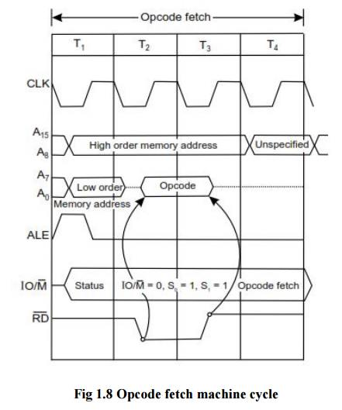
a) Opcode Fetch Machine cycle
Each instruction of the processor has one byte opcode.
The opcodes are stored in memory. So, the processor executes the opcode fetch machine cycle to fetch the opcode from memory.
every instruction starts with opcode fetch machine cycle.
The time taken by the processor to execute the opcode fetch cycle is 4T.
In this time, the first, 3 T-states are used for fetching the opcode from memory and the remaining T-states are used for internal operations by the processor.

Slide 48

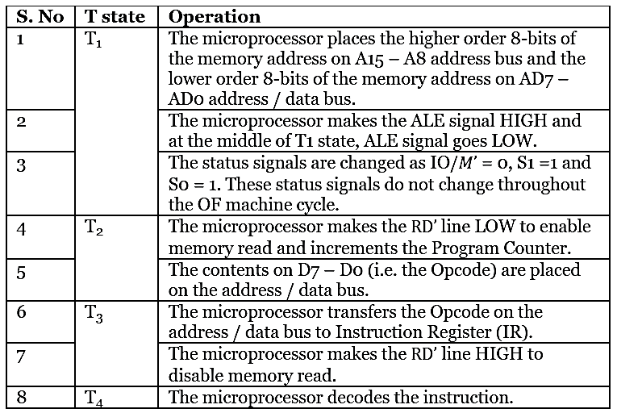
The steps in Opcode Fetch machine cycle are

Slide 49
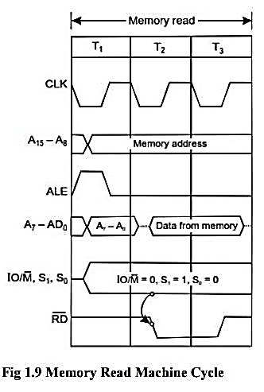
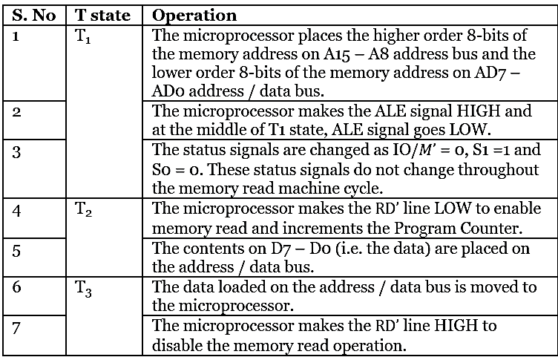
b) Memory Read Machine cycle
The memory read machine cycle is executed by the processor to read a data byte from memory.
The processor takes 3T states to execute this cycle.
The steps in Memory Read machine cycle are

Slide 50
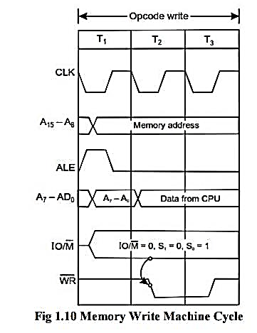
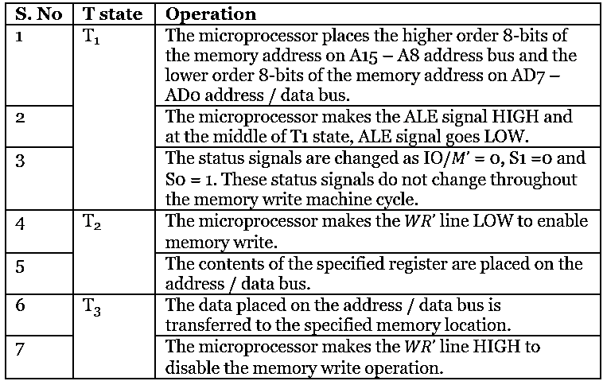
c) Memory Write Machine cycle
The memory write machine cycle is executed by the processor to write a data byte in a memory location.
The processor takes, 3T states to execute this machine cycle.

Slide 51
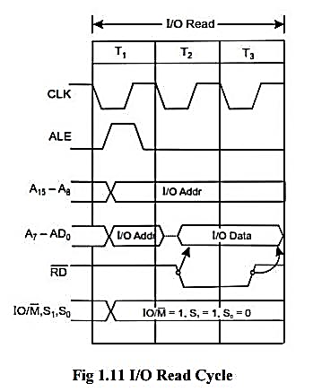
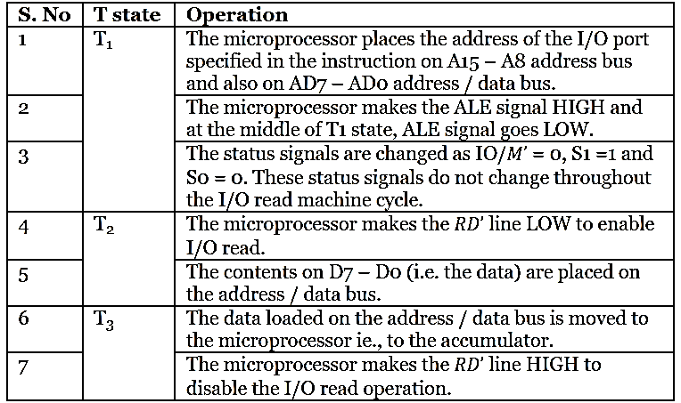
d) I/O Read Machine cycle
The I/O Read cycle is executed by the processor to read a data byte from I/O port or from the peripheral, which is I/O, mapped in the system.
The processor takes 3T states to execute this machine cycle.

Slide 52
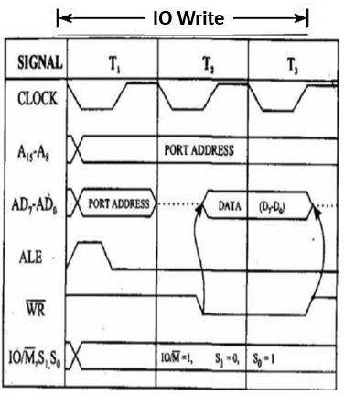
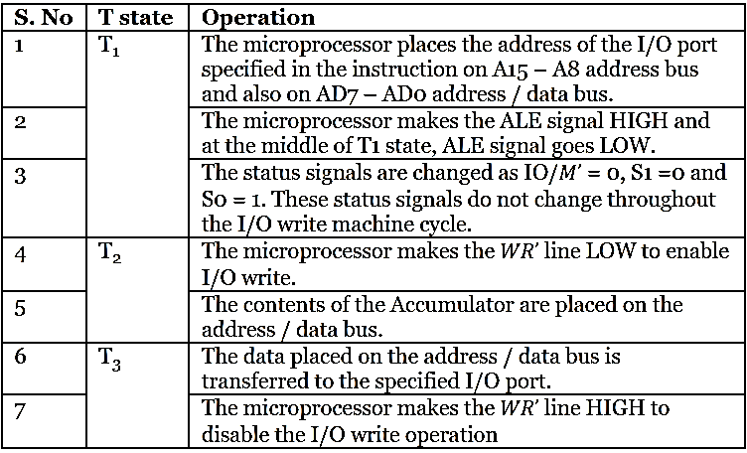
e) I/O Write Machine cycle
The I/O Write cycle is executed by the processor to write a data byte to I/O port or to the peripheral, which is I/O, mapped in the system.
The processor takes 3T states to execute this machine cycle.

Slide 53
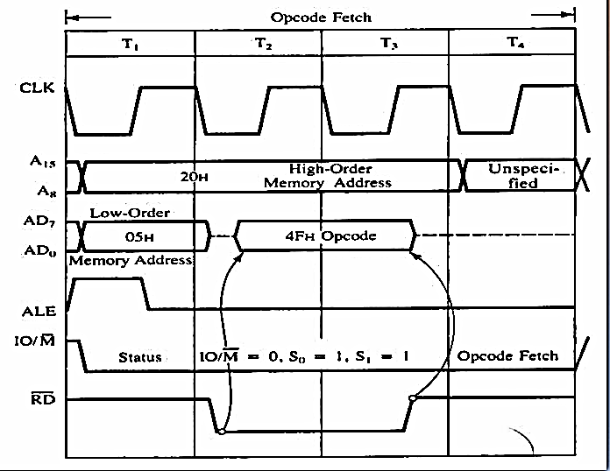
1. Timing Diagram for: MOV A, B
Assume Address: 2005 H, Opcode: 78H
Here 20 is higher order address and 05H is Lower Address.
78H
Reference:
https://www.youtube.com/watch?v=KQ18sRHBpTM

Slide 54
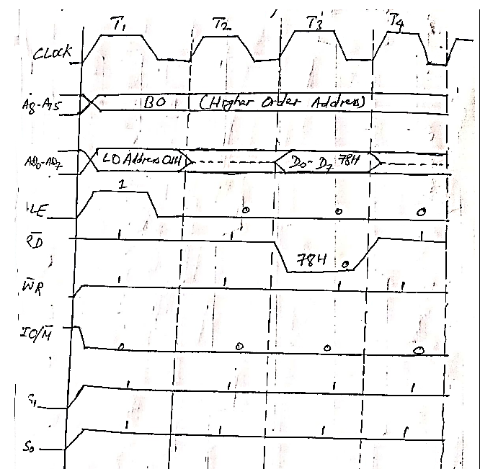
or
Assume Address: B001 H, Opcode: 78H
Here B0 is higher order address and 01H is Lower Address.

Slide 55
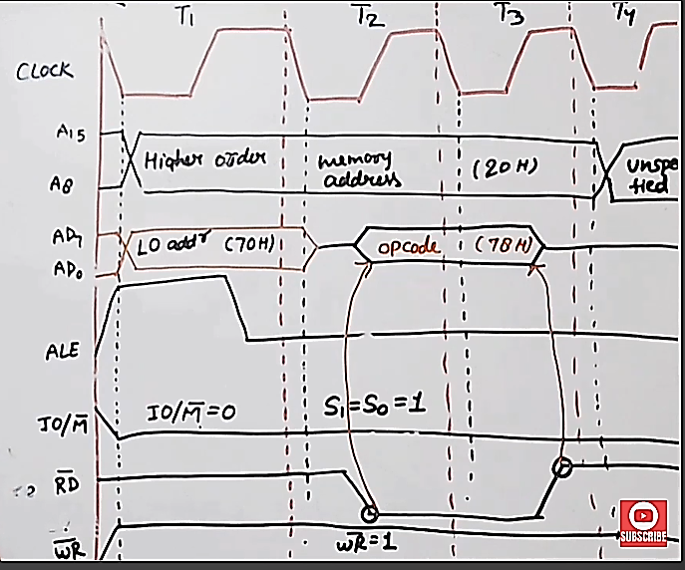
Or
Assume Address: 2070 H, Opcode: 78H
Here 20 is higher order address and 70H is Lower Address.
Reference:
https://www.youtube.com/watch?v=KQ18sRHBpTM

Slide 56
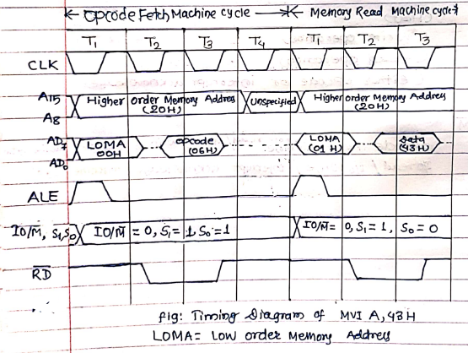
2. Timing Diagram for: MVI A,43 H
Assume
Here 20 is higher order address and 00H is Lower Address.
Involves:
Fetching the opcode 06H from the memory 2000H (Opcode Machine Cycle)
Read (Move) the data 43H from memory 2001H (i.e. Memory Read Machine Cycle)
Address | Mnemonics | Hexcode
2000H | MVI A, 443H | 06H
2001H |  | 43H
78H

Slide 57
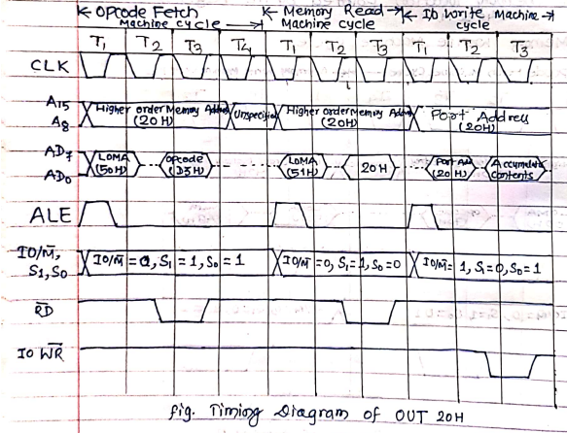
3. Timing Diagram for: OUT 20H
Assume
Here 20 is higher order address and 50H is Lower Address.
Involves:
Opcode Machine Cycle : Fetching the opcode D3H from the memory 2050H
Memory Read Machine Cycle: Read the port address 20H from the memory 2051H
IO Write Machine cycle: Transfer the content of Accumulator to the output port 20H
Address | Mnemonics | Hexcode
2050H | OUT | D3H
2051H |  | 20H
78H

Slide 58
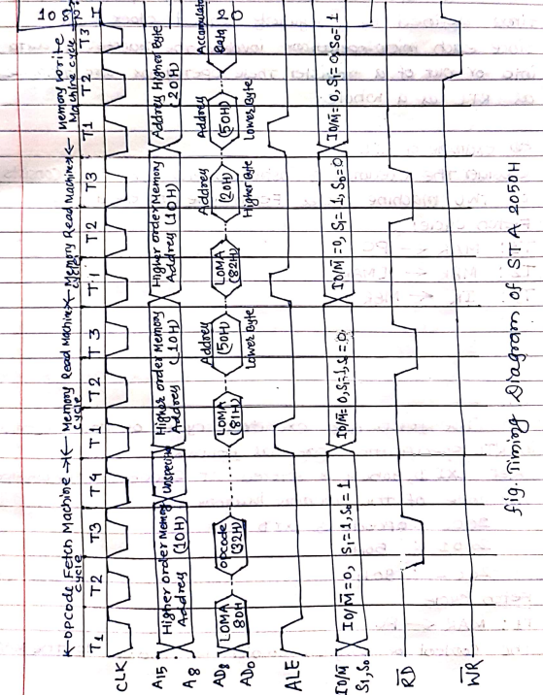
4. Timing Diagram for: STA 2050H
Assume
The instruction copies the accumulator into the memory location 2050H. It is a 3-byte instruction and the MP needs four machine cycles (13 T-state) to complete its execution.
Address | Mnemonics | Hexcode
1080H | STA | 32H
1081H |  | 50H
1082H |  | 20H
78H

Slide 59
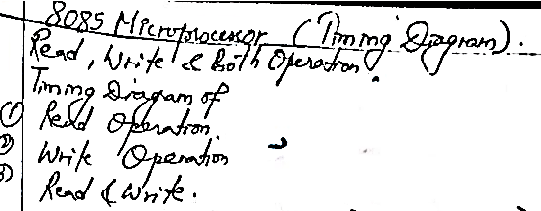
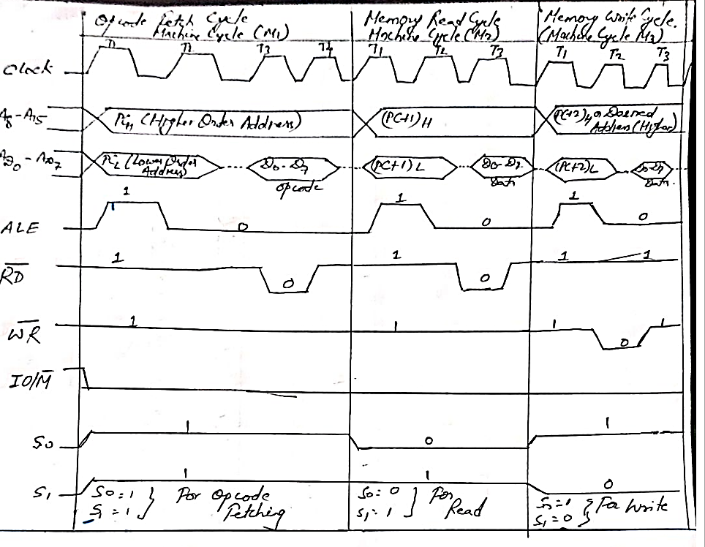

Slide 60
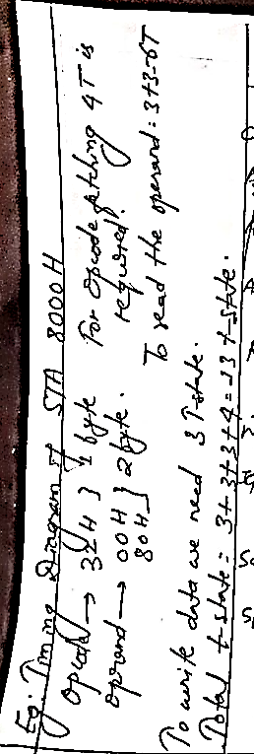
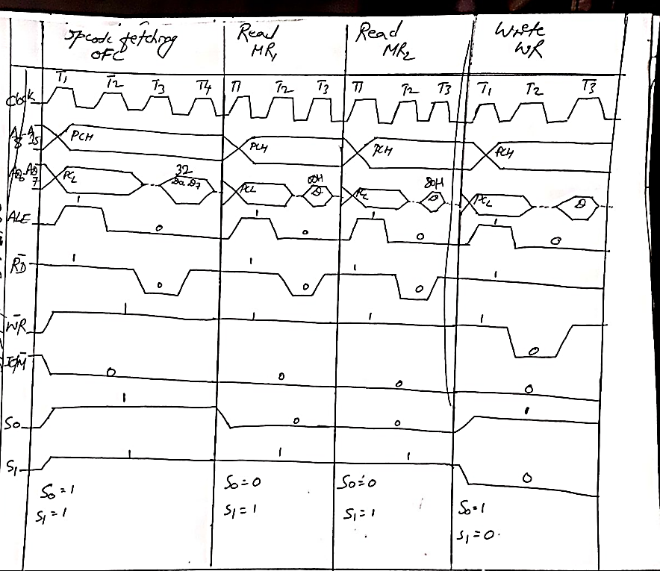

Slide 61
The flow of an Instruction in 8085 architecture
Execution starts with PC. It starts the program execution with next address field. It fetches the instruction from the memory location pointed by PC.
For address fetching from memory, multiplexed address/data bus acts as an address bus and after fetching instruction, this address bus will now act as a data bus and extract data from the specified memory location, and send this data on an 8-bit internal bus. For multiplexed address/data bus, address Latch Enable (ALE) pin is used. This allows the input address to be entered to a register. If ALE=1, multiplexed bus is address bus, otherwise it acts as Data bus.
After data fetching, it will go into the IR. It will store data fetched from memory and data is now ready for decoding. (Instruction decoder is used)
After that, Timing and control comes into the account. It sends control signals to all over the microprocessor to tell it whether the given instruction is for READ/WRITE, and whether it is for Memory of IO devices activity.
According to the timing and control signal pins, logical and arithmetic operations are performed (ALU).
With the help of Serial I/O data pin (SID and SOD), we can send or receive input/output to external devices. In this way, execution cycle is carried out.
While execution is going on if there is any interrupt detected, then it will stop execution of the current process and invoke ISR (Interrupt service routine) function, which will stop the current execution and do the execution of current occurred interrupt.

Slide 62
5. Basic Assembly language programs of 8085

Slide 63
1. Write an ALP for 8085 MP to store an immediate 8-bit data in memory location 2051H using direct addressing.
Test Ok
MVI A,49H ; "Store 49H in the accumulator"
STA 2501H ;"Copy accumulator contents at address 2501H"
HLT ; "Stop"

Slide 64
2. Write an ALP for 8085 MP to store 8-bit data in memory 2501H using indirect addressing.
Test Ok
LXI H,2501H ; "Load H-L pair with 2501H"
MVI M,49H ; "Store 49H in memory location pointed by H-L register pair (2501H)"
HLT ; "Stop"

Slide 65
3. Write an ALP for adding two 8-bit numbers 02H and 03H using immediate addressing . The result is to be stored in 1050 H.
Test Ok
MVI A, 02H ; “Get the first number and move to accumulator”
MVI B, 03H ; “Get the second number and move to register B"
ADD B ; "Add the second number with the content of accumulator"
STA 1050H ; "Store result at 1050H"
HLT ; "Stop"

Slide 66
4. Write an ALP for adding two 8-bit numbers stored in 2501H and 2502H. The result is to be stored in 2503H.
Test Ok
LXI H, 2501H ; "Get address of first number in H-L pair. Now H-L points to 2501H"
MOV A, M ; "Get first operand in accumulator"
INX H ; "Increment content of H-L pair. Now, H-L points 2502H"
ADD M ; "Add first and second operand"
INX H ; "H-L points 2503H"
MOV M, A ; "Store result at 2503H"
HLT ; "Stop"

Slide 67
5. Write an ALP for subtracting two 8-bit numbers stored in 2501H and 2502H. The result is to be stored in 2503H.
Test Ok
LXI H, 2501H ; "Get address of first number in H-L pair. Now H-L points to 2501H"
MOV A, M ; "Get first operand in accumulator"
INX H ; "Increment content of H-L pair. Now, H-L points 2502H"
SUB M ; "Subtract first to second operand"
INX H ; "H-L points 2503H"
MOV M, A ; "Store result at 2503H"
HLT ; "Stop"

Slide 68
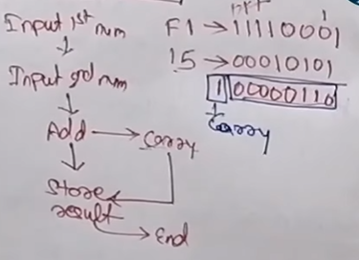
6. Write an assembly language program to add two 8-bit numbers (F1 and 15), stored at C050H and C051H, with carry.
Test Ok
LXI H, C050H ; "Get address of first number in H-L pair. Now H-L points to C050H"
MOV A, M ; "Get first operand in accumulator from C050H"
INX H ; "Increment content of H-L pair. Now, H-L points C051H"
MVI B, 00H ; “Initialize Register B with 00H for carry store”
ADD M ; "Add first and second operand, result stored in Acc"
JNC label ; “Jump to label if no carry”
INR B ; “Increment content of B by 1”
label: STA C053H ; “Store the content of Acc to C053H”
MOV A, B ; “Move carry at Acc"
STA C052H ; “Store the content of Acc to C052H, ie the carry part”
HLT ; "Stop"
; “Carry part store in C052H and sum is store in C053H”
Reference: https:;www.youtube.com/watch?v=GLfEQGY70Ek&list=PLndX8heiWwErijxt7FpnRilO2KV4UhFmN

Slide 69
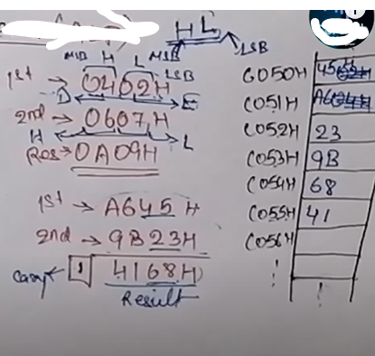
7. Write an assembly language program to add two 16-bit numbers A645 and 9B23, stored from C050H onwards, with carry.
Test Ok
LHLD C050H ; "Get address of first number from memory and load in in H-L register”
XCHG ; Exchange H and L with D and E
LHLD C052H ; "Get address of second number from memory and load in in H-L register”
MVI B, 00H ; “Initialize Register B with 00H for carry store”
DAD D ; Add both the register pairs and store in HL, ie. HL+DE
JNC label ; “Jump to label if no carry”
INR B ; “Increment content of B by 1”
label: SHLD C054H ; “Store the content of H-L register to C054H”
MOV A, B ; “Move carry at Acc"
STA C056H ; “Store the content of Acc to C056H, ie the carry part”
HLT ; "Stop"
; “Carry part store in C056H and sum is store in C054H-C055H”
Reference: https:;www.youtube.com/watch?v=_4Q-upoIv8c&list=PLndX8heiWwErijxt7FpnRilO2KV4UhFmN&index=2

Slide 70
8. Write a program in Assembly language to interchange(Swap) the contents of two memory location 2100H and 2101H.
Test Ok
LDA 2100H ; “Load the content of 2100H into Accumulator”
MOV B,A ; “Move content of Acc to register B”
LDA 2101H ;“Load content of 2101H to Accumulator”
STA 2100H ; “Store content of Acc. to 2100H”
MOV A,B ; “Move content of register B to Acc.”
STA 2101H ; “Store content of Acc. To 2101H”
HLT ; “End”

Slide 71
8. Write a program in Assembly language to multiply two 8 bit numbers stored at C050H and C051H.
Test Ok
LXI H,C050H ; Get address of first number in H-L pair. Now H-L points to C050H"
MOV B,M ; Get first operand in register B from C050H"
MVI A,00H ;Clear Accumulator
MVI D, 00H ;Initialize a register D with 00H for carry storage
INX H ; point to C051H
MOV C,M ;Get the second operand
loop1: ADD B ;Add contents in register B with Accumulator
JNC loop2 ; Jump to loop2 if no carry
INR D ;increase D
loop2: DCR C ;Decrement counter C
JNZ loop1 ;Jump to loop1
STA C052H ;Store the content to C052H
MOV A,D ;Move D to A.
STA C053H ;Store content of Acc. To C053.
HLT
5x3*15
5+5+5=15

Slide 72
Assignment:
Write a program, which load register B with 37H and copy the number in accumulator and send the number to the memory location 2000H.
Write a program, which load 37H and 45H. Find the sum of two number and send the result in 2050H.
Write assembly language program using the instruction of 8085. Load the contents of memory location 2100H and 2101H in B register and C-Register respectively. The content of memory location 2100H and 2101H are 16H and 19 H respectively.
Write an assembly language program to multiply two decimal numbers 23 and 9 and store the answer in some memory location.

Slide 73
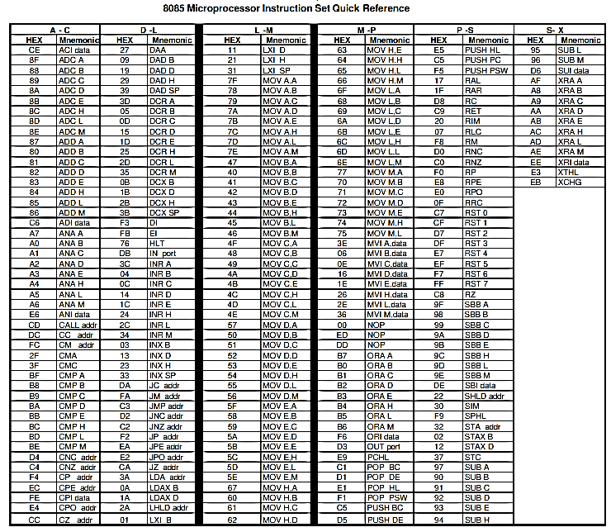

Slide 74
Register Transfer Language (RTL)

Slide 75
Register Transfer Language (RTL)
The symbolic notation used to describe the micro-operation transfers amongst registers is called Register transfer language.
Register Transfer Language, RTL, (sometimes called register transfer notation) is a powerful high level method of describing the architecture of a circuit.
Information transfer from one register to another is designated in symbolic form by means of a replacement operator.
For example: R2← R1
The statement denotes a transfer of the content of register R1 into register R2. It designates a replacement of the content of R2 by the content of R1.
By definition, the content of the source register R1 does not change after the transfer.

Slide 76
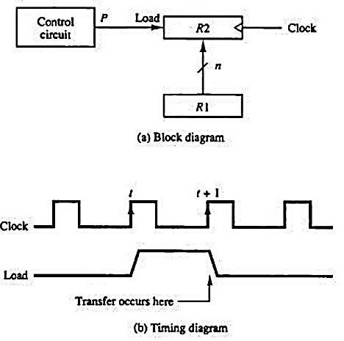
Register Transfer
Information transferred from one register to another is designated in symbolic form by means of replacement operator.
R2 ← R1
It denotes the transfer of the data from register R1 into R2.
Normally we want the transfer to occur only in predetermined control condition. This can be shown by following if-then statement:
if (P=1) then (R2 ← R1)
Here, P is a control signal generated in the control section.

Slide 77
Control Function
A control function is a Boolean variable that is equal to 1 or 0. The control function is shown as:
P: R2 ← R1
The control condition is terminated with a colon.
It shows that transfer operation can be executed only if P=1.
If two or more operations are to occur simultaneously, they are separated with commas.
Example:
P: R2 ←R1, MAR ←IR

Slide 78
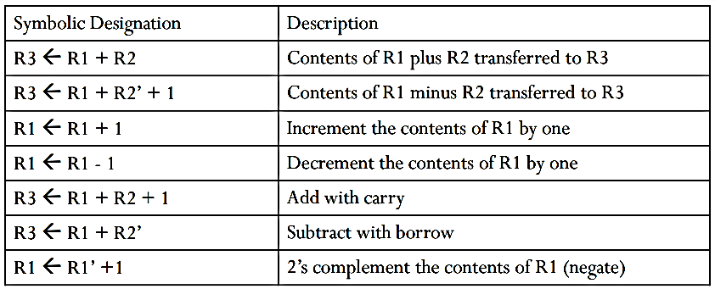
Arithmetic Microoperation
The operations executed on data stored in registers are called microoperations.
Examples of microoperations are shift, count, clear and load

Slide 79
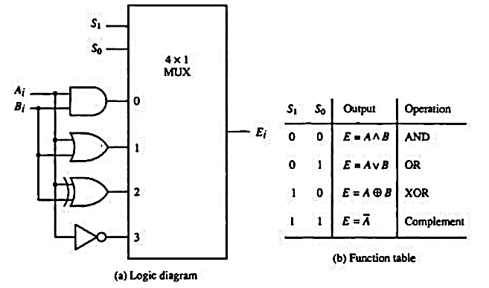
Logic Microoperation
Microoperation | Name
F←R1^ R2 | AND
F← R1 v R2 | OR
F← R1 ⊕ R2 | XOR
F← R1’ | Complement (NOT)
Figure: Hardware Implementation

Slide 80
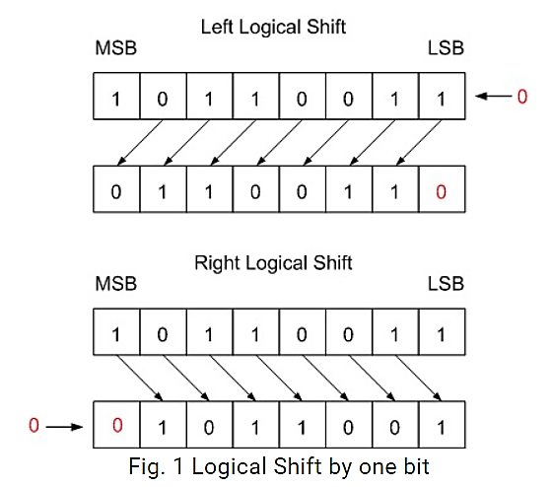
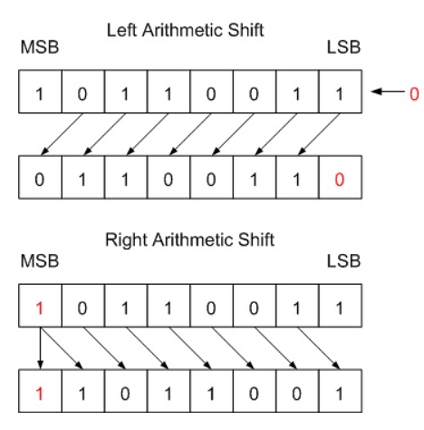
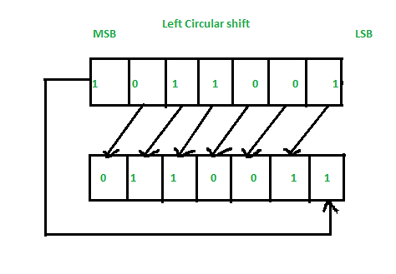
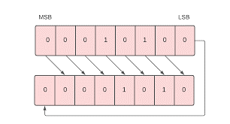
Shift Microoperation
Microoperation | Name
R← shl R | Shift-left register R
R← shr R | Shift-right register R
R← ashl R | Arithmetic left shift register R
R← ashr R | Arithmetic right shift register R
R←cil R | Circular shift-left register R
R←cir R | Circular shift-right register R
Fig: Logical shift by 1 bit
Fig: Arithmetic shift by 1 bit
Fig: Circular left shift by 1 bit
Fig: Circular right shift by 1 bit

Slide 81
RTL
Register Transfer Language (RTL) is the symbolic representation of the steps that expresses the transfer of data among the registers.
The RTL shows all the microoperations that occur during fetch and execution cycle of an instruction.
These micro-operations occur in equally spaced units of time defined by a regularly spaced clock pulse.
Since each micro-operation involves the transfer of data into or out of a register, these operations are termed as RTL as a whole.
Microprocessor need to transfer data between register to perform specific task. The only way to understand about the transfer of data between register is RTL.
This helps programmer to understand and have clear view about transfer of data between register in executing some instructions.

Slide 82
Specifying with RTL for LXI D, 9050H
This instruction loads 16-bit data 9050H in register pair DE such that Low-order byte 50H is loaded into the register D.
Let LXI D, 9050H is stored at 2000H. So the corresponding hex-code of the memory locations are:
2000: opcode of LXI D
2001: 50H
2002: 90H
The fetch and execution cycle of this instruction in RTL specification are as follows:
2000H:
Opcode of LXI D
50H
90H
2001H:
2002H:
2003H:
2005H:
Memory

Slide 83
a) Fetch Cycle:
T1: MAR← PC
The content of PC is moved to the MAR.
The PC contains the address of next instruction to be executed.
MAR is 16-bit register that holds the address of memory temporarily during read/write operation.
So, now MAR has 2000H.
T2: MBR← [MAR]
The content of memory pointer by MAR is moved to MBR.
MBR is memory buffer register that holds data temporarily before writing in memory or after reading from the memory.
So, MBR will now have opcode of LXI D
T3: IR ←MBR, PC←PC+1
The content of MBR (ie. opcode of LXI D) is now sent to IR.
The content of IR is decoded and PC increment by 1.
T4: unspecified
b) Execute cycle:
Machine cycle M1
T1: MAR← PC
The new content of PC (i.e 2001) is sent to MAR
T2: MBR← [MAR]
The content of location 2001H (ie. 50H) is sent to MBR
T3: E←MBR, PC←PC+1
This lower order byte 50H is sent to register E and PC is incremented by 1.
Machine cycle M2
T1: MAR←PC
The new content of PC, ie. 2002H is sent to MAR
T2: MBR←[MAR]
The content of location 2002H, ie. 90H is sent to MBR
T3: D←MBR
The higher order byte 90H is sent to register D.

Slide 84
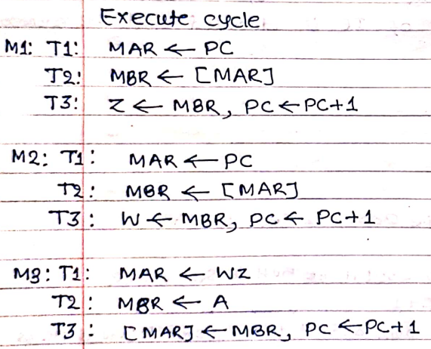
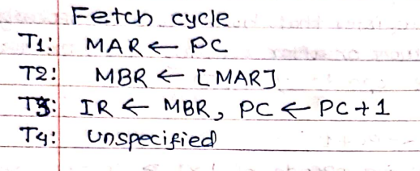
STA 2000H using RTL specification
This instruction copies the contents of the accumulator to the memory location 2000H. It is 3-byte instruction and requires 4 machine cycles (13T states) for its execution.
The RTL for this instruction are shown below:

Slide 85
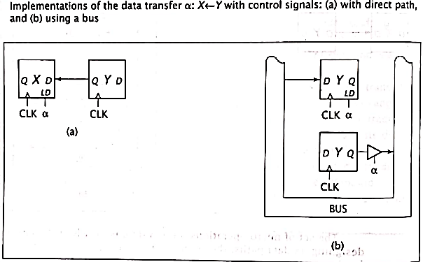
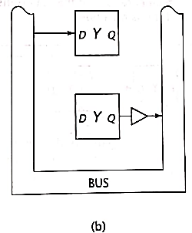

Some RTL implementation
RTL can be used to specify the behavior of any sequential digital system, simplest to complex.
RTL specify the function of digital components and simple systems.
x

Slide 86



Slide 87



Representation of D flipflop with RTL
Consider the D flip-flop as shown in figure (a).
Its function can be expressed by single RTL statement.
LD: Q←D
When LD input is high, the value on the D input is loaded and made available on the Q output. This happens on rising edge of clock pulse.
In figure b, when CLR =1, the flipflop set to 0.
i.e.
LD: Q← D
CLR: Q←0
However, When D, LD and CLR are equal to 1, the above system fails.
When LD=1, the Q is set to 1
And when CLR=1, Q is clear to 0,
Both set Q simultaneously, Which is not possible.
The solution is to modify the conditions so they are mutually exclusive.
Here, Q is set to 1 if CLR=0 and LD=1.
D Flipflop truth table

Slide 88


Another Example: JK
Consider the JK flip flop without a CLR input.
Its truth table is:
Its behavior can be specified in RTL as follow:
When J=0 and K=0, no condition is met and the flip-flop retains its previous value. No RTL statement is included for this case because no transfer is needed.

Slide 89



Specification and Implementation of Simple Systems with RTL
Consider a system with four 1-bit flipflops. Given RTL code where j, o, h and n are conditions which are mutually exclusive.
But it does not complete the transfer.
No register has actually loaded any data yet.
It is necessary to assert LD signal.
The complete circuit, with LD signal is shown as below.
The flipflop M is loaded when j=1 (M←A) or n=1 (M←R).
Logically, ORing these signals together produces LD input for M flipflop.
Similarly for other conditions.

Slide 90


Buses can be implemented using either tri-state buffers or multiplexers.
Figure aside shows the complete design of the system to implement RTL code using a bus and tri-state buffers.
Reference
It is also possible to implement a system bus using a multiplexer.
MUX can be used instead of tri-state buffers.
n o j

Slide 91

Classwork:

Slide 92




Slide 93


Solutions:

Slide 94



Slide 95


Slide 96



Slide 97


Slide 98

Assignment:
Implement the given RTL codes into a single system using bus. . [PU 2017 Fall]
R1← R2, R3← R2
R2 ← R3
R3 ← R1, R2←R1
Define RTL. Design a system that could implement the given RTL codes sing direct connection: [PU 2019 Spring]

Slide 99
Assignment:
Uses of 8085 MP
Issues in 8085 MP

Slide 100
Uses of 8085 MP
Embedded Systems
Computer peripherals
Communication System
Instrumentation and Control System
Home Appliances
Educational purposes.

Slide 101
Issues in 8085 MP
Overheating
Power supply issue
Timing issues
Hardware Interface issues
Programming issues
Research and Development
Retro computing

Slide 102
End of chapter 2

